Slide 1
Summative Assessment

Slide 2
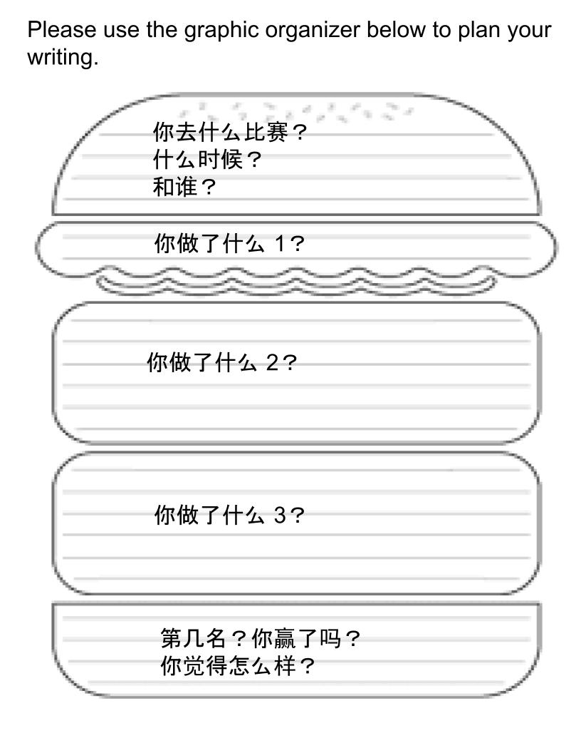
Summative Assessments:
Task 1:
Presentational Writing. After reading the stories of the competitive athletes, please write a narrative paragraph to share your experience participating in any competition.

Slide 3
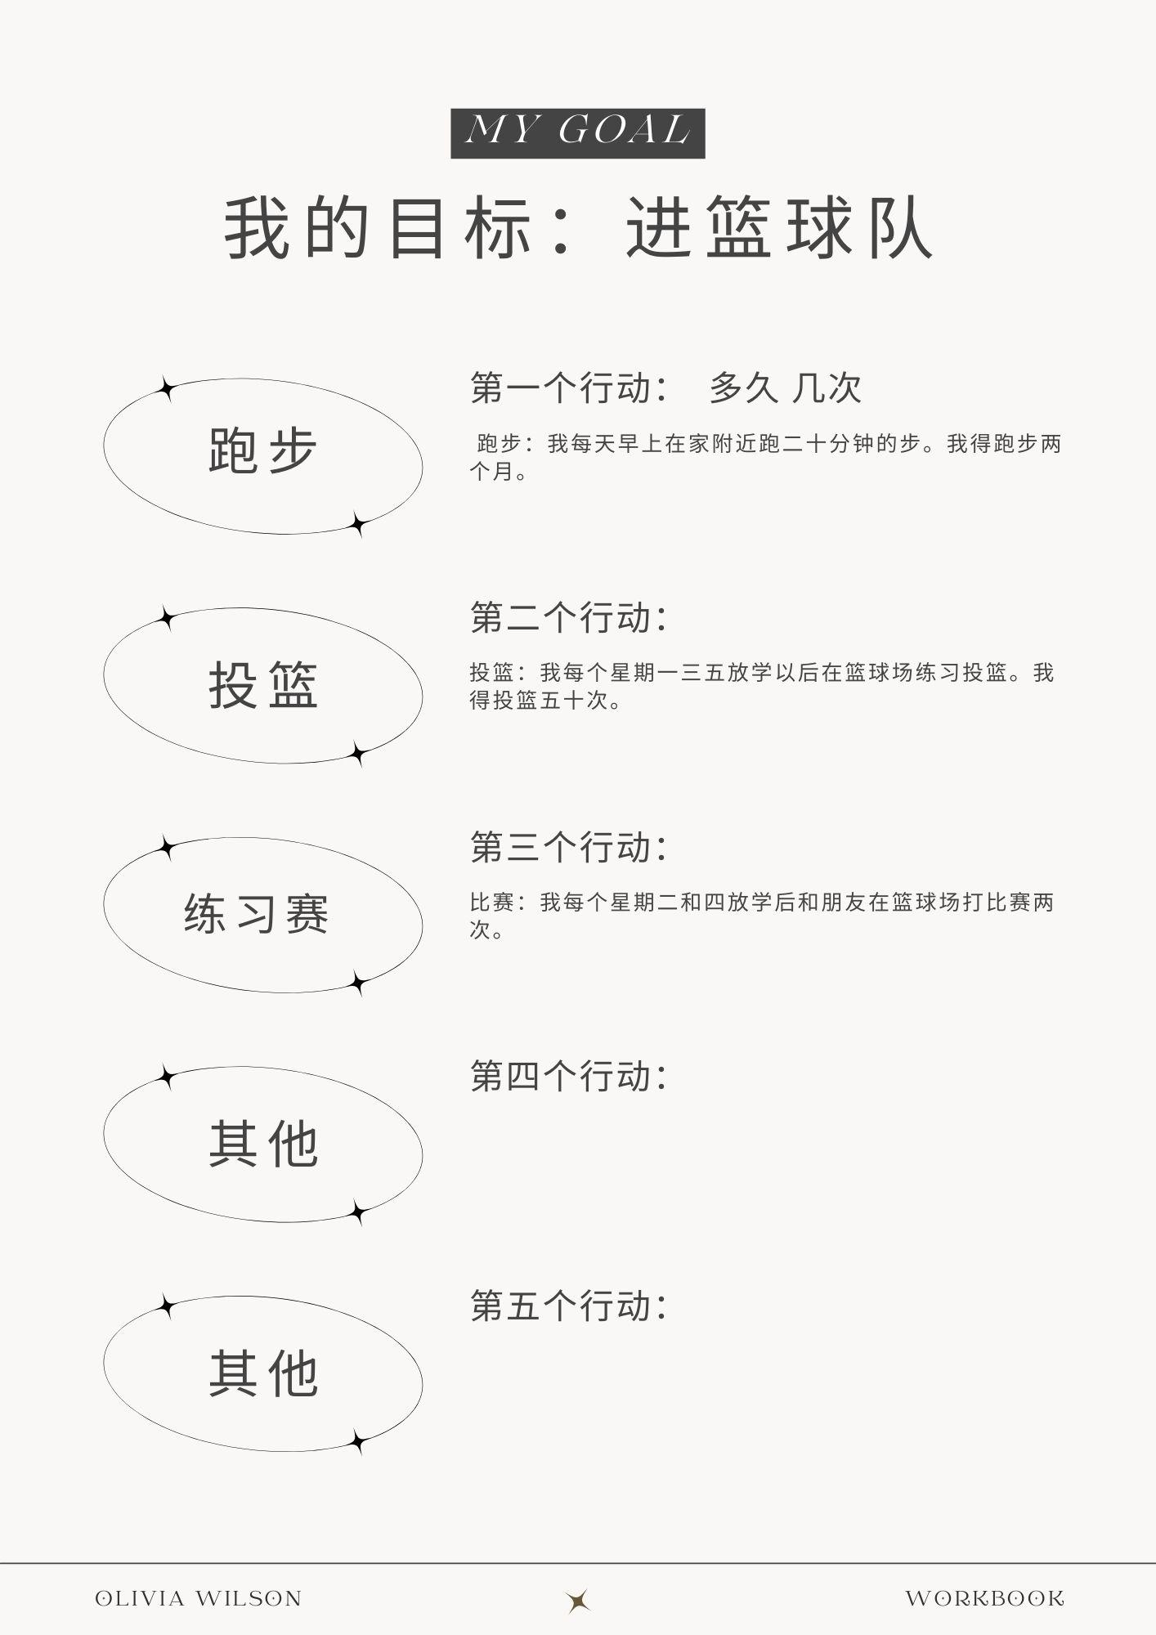
Summative Assessments:
Task 2:
Presentational Writing. And create a plan to share with your new friend listing all the goals and the actions you will take for the tryout (graphic organizer). Share your reflection after 2 weeks.

Slide 4
Summative Assessments:
Biweekly attendance cards：Students will record their completion of the program for the two weeks and complete a Self-Evaluation, students can put 好/中/不好 for that.
第一周 | 星期一 | 星期二 | 星期三 | 星期四 | 星期五 | 星期六/日
跑步
投篮
练习比赛
第二周 | 星期一 | 星期二 | 星期三 | 星期四 | 星期五 | 星期六/日
跑步
投篮
练习比赛

